Slide 1
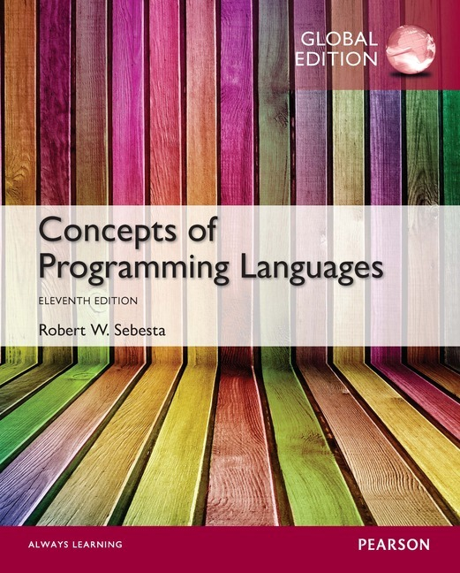
Chapter 2 Part 2
Evolution of the Major Programming Languages

Slide 2
Chapter 2 Topics
The First Step Toward Sophistication: ALGOL 60
Computerizing Business Records: COBOL
The Beginnings of Timesharing: BASIC
Everything for Everybody: PL/I
Two Early Dynamic Languages: APL and SNOBOL

Slide 3
Genealogy of Common Languages

Slide 4
The First Step Toward Sophistication: ALGOL 60
Environment of development
FORTRAN had (barely) arrived for IBM 70x
Many other languages were being developed, all for specific machines
No portable language; all were machine- dependent
No universal language for communicating algorithms
An effort to design a universal language
Universal in terms of machine independence
ALGOL 60 was still a scientific language

Slide 5
Early Design Process
ACM and GAMM met for four days for design (May 27 to June 1, 1958)
International Algorithmic Language (IAL), then renamed ALGOrithmic Language
Goals of the language
Close to mathematical notation
Good for describing algorithms
Must be translatable to machine code

Slide 6
ALGOL 58
Concept of type was formalized
Names could be any length
Arrays could have any number of subscripts
Parameters were separated by mode (in & out)
Subscripts were placed in brackets, lower bound could be specified by the programmer
Compound statements (begin ... end)
Semicolon as a statement separator
Assignment operator was := (evolved from <=)
The if had else-if clause, could be nested
No I/O - “would make it machine dependent”

Slide 7
ALGOL 58 Implementation
Not meant to be implemented, but variations of it were (MAD, JOVIAL)
Although IBM was initially enthusiastic, all support was dropped by mid 1959

Slide 8
ALGOL 60 Overview
Modified ALGOL 58 at 6-day Paris meeting
New features
Block structure with local scope
Pass by value and pass by name allowed as parameter passing methods
Subprogram recursion (first to introduce this feature for imperative languages)
Stack-dynamic arrays (allowed run-time size declaration of arrays)
BUT still no I/O and no string handling

Slide 9
ALGOL 60 Evaluation
Successes
It was the standard way to publish algorithms for over 20 years
Basis for all subsequent imperative languages
First machine-independent language
First language whose syntax was formally defined (BNF)

Slide 10
ALGOL 60 Evaluation (continued)
Failure
Never widely used, especially in U.S.
Reasons
Lack of I/O and the character set made programs non-portable
Too flexible – hard to understand and implement
Formal syntax description was confusing at the time
Entrenchment of Fortran
Lack of support from IBM

Slide 11
Computerizing Business Records: COBOL
First Common Business Language (CBL), then COmmon Business-Oriented Language
Environment of development
Only a few proprietary business languages
UNIVAC was beginning to use FLOW-MATIC
USAF was beginning to use AIMACO
IBM was developing COMTRAN

Slide 12
COBOL Historical Background
Based on FLOW-MATIC
FLOW-MATIC features
Names up to 12 characters, with embedded hyphens
English names for arithmetic operators (no arithmetic expressions)
Data and code were completely separate
The first word in every statement was a verb

Slide 13
COBOL Design Process
First Design Meeting (Pentagon) in May 1959
Design goals
Must look like simple English
Must be easy to use, even if that means less power
Must broaden the base of computer users
Must not be biased by current compiler problems
Design committee members were all from computer manufacturers and DoD branches
Design Problems
Arithmetic expressions?
Subscripts?
Fights among manufacturers

Slide 14
COBOL Evaluation
Contributions
First macro facility in a high-level language
Hierarchical data structures (records)
Nested selection statements
Long names (up to 30 characters), with hyphens
Separate and very detailed data division
Drawbacks
Relatively weak procedure division
Initially no subprograms with parameters

Slide 15
COBOL: DoD Influence
First language required by DoD
Would probably have failed without DoD
Poor compiler performance increased costs
Still the most widely used business applications language

Slide 16
The Beginning of Timesharing: BASIC
Beginner’s All-Purpose Symbolic Instruction Code
Designed by Kemeny & Kurtz at Dartmouth
Design Goals:
Easy to learn and use for non-science students
Must be “pleasant and friendly”
Fast turnaround for homework
Free and private access
User time is more important than computer time
First widely-used language with time sharing
Current popular dialects
Visual BASIC
VB.NET

Slide 17
Everything for Everybody: PL/I
Programming Language One
Designed by IBM and SHARE
Computing situation in 1964 (IBM’s view)
Scientific computing
IBM 1620 and 7090 computers
FORTRAN
SHARE user group
Business computing
IBM 1401, 7080 computers
COBOL
GUIDE user group

Slide 18
PL/I: Background
By 1963
Scientific users needing better I/O, like COBOL
Business users needing floating point and arrays (for MIS)
A problem was developing for organizations
Two kinds of computers, languages, and support staff
Far too costly
The obvious solution
Build a new computer for both applications
IBM System/360 line
Design a new language for both applications
Systems programming & list processing too

Slide 19
PL/I: Design Process
Designed in 5 months by 3x3 Committee
Three members from IBM
Three members from SHARE
Initial concept
An extension of Fortran IV called Fortran VI
Quickly refocused into a new language
Initially NPL (New Programming Language)
Name changed to PL/I in 1965

Slide 20
PL/I: Evaluation
PL/I contributions
First unit-level concurrency
First exception handling
Switch-selectable recursion
First pointer data type
First array cross sections
Concerns
Many new features were poorly designed
Too large and too complex – tried to incorporate all available constructs

Slide 21
Two Early Dynamic Languages: APL and SNOBOL
Both are characterized by
Dynamic typing
Variable acquires a type when it is assigned a value
Dynamic storage allocation
Variable storage allocated when value is assigned

Slide 22
APL
A Programming Language
Designed at IBM by Ken Iverson circa 1960
Initially a hardware description language
Highly expressive (many operators, for both scalars and arrays of various dimensions)
Programs are very difficult to read
Still in use with minimal changes

Slide 23
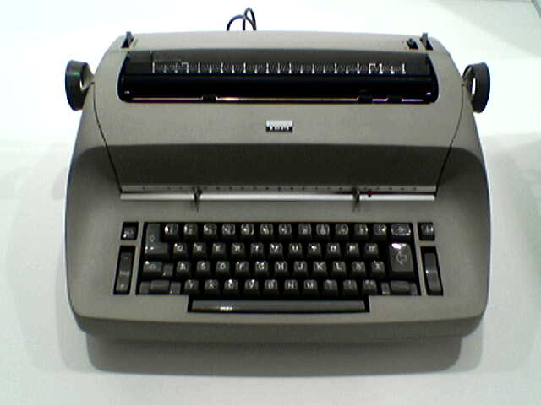
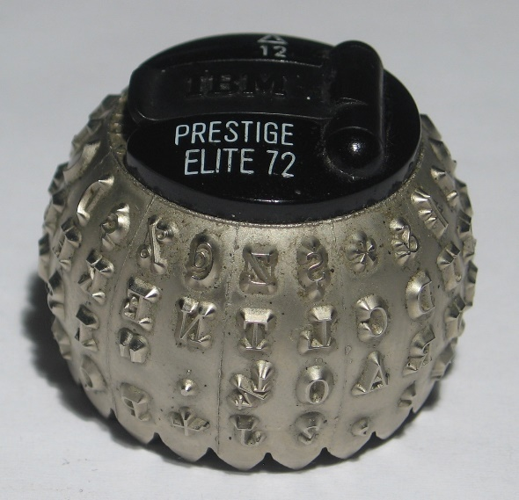
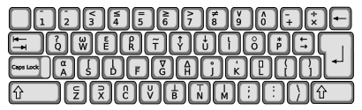
APL
IBM Selectric typewriter
and printball
APL keyboard
overlay

Slide 24
APL
Examples of APL programs
Sort a list of words according to word length
Generate 6 non-repeating pseudo-random integers between 1 and 40, and print them in ascending order
Find all the prime numbers from 1 to R

Slide 25
SNOBOL
Designed at Bell Labs by Farber, Griswold, and Polensky in 1964
A string manipulation language
Powerful operators for string pattern matching
Initially used for writing text editors
Slower than alternative languages
Thus no longer widely used for this purpose
Still used for certain text processing tasks

